Slide 1
Week # 01 Professional Practice (IT)

Slide 2
Ethics in Information
Technology, Fourth Edition
Chapter 1
An Overview of Ethics
Ethics in Information Technology by Reynolds 5th edition

Slide 3
Objectives
As you read this chapter, consider the following
questions:
What is ethics, and why is it important to act according to a code of ethics?
Why is business ethics becoming increasingly important?
What are organizations doing to improve their business ethics?

Slide 4
Objectives (cont’d.)
Why are organizations interested in fostering good business ethics?
What approach can you take to ensure ethical decision making?
What trends have increased the risk of using information technology in an unethical manner?
Notes:
Fostering: development

Slide 5
What is Ethics?
Moral code
Set of rules
Establishes boundaries of generally accepted behavior
Why these rules?
Different rules often have contradictions
Morality
Social agreements about right and wrong
Widely shared
Form basis for an established agreement
Notes:
Conventions: contracts
Moral: see cheating of friend lose of loyalty then what about organization if check mails and internet usage while u support personal privacy?

Slide 6
What is Ethics? (cont’d.)
Morality may vary by:
Age
Cultural group
Cultural background
Religion
Life experiences
Education
Gender
Notes:
Ethnic: traditional, trible

Slide 7
Definition of Ethics
Ethics
Set of beliefs about right and wrong behavior
Virtues
Habits that incline people to do what is acceptable
Vices
Habits of unacceptable behavior
Virtues and vices define a personal value system
Scheme of moral values
Notes:
Software piracy is 43% in US in 2011 for all products
Virtue (Quality): loyal, fairness, truthful
Learned driving, swimming writing out of nature habits but acceptable
Vice(sin, badness): greed, jealousy, angry

Slide 8
The Importance of Integrity
Integrity is a cornerstone(bases) of ethical behavior
People with integrity:
Act in accordance with a personal code of principles
Extend to all the same respect and consideration
Apply the same moral standards in all situations
Unfortunately, consistency, difficult to achieve.
Lack of integrity appears if you apply moral standards differently according to situation or people involved
Many ethical problems are not as simple as right
versus wrong
Notes:
Integrity: Honesty, truthful, honor, reliable
Emerged: raised, occur
As a child no cheat, lie but with growth….

Slide 9
The Difference Between Morals, Ethics, and Laws
Morals: one’s personal beliefs about right and wrong
Ethics: standards or codes of behavior expected of an individual by a group
Law: system of rules that tells us what we can and
cannot do
Laws are enforced by a set of institutions
Legal acts follow to the law
Moral acts follow to what an individual believes is the right belief of right and wrong
Notes:
Ethics: what you think who should be a good teacher/political person/businessman?
In child age, no cheat, no lie but with time tell lie for respect other’s feelings.
What about co-worker if he lie?
Cut corner to meet project deadline?
Consistency difficult to achieve
Overtime to pay may boost loyalty and motivation but if no budget and employer force to overtime?
Tell lie in favor of employer or services..
System: police, courts, law suit makers etc.

Slide 10
 | Ethics | Morals
What are they? | The rules of conduct recognized in respect to a particular class of human actions or a particular group or culture. | Principles or habits with respect to right or wrong conduct. While morals also prescribe dos and don'ts, morality is ultimately a personal compass of right and wrong.
Where do they come from? | Social system - External | Individual - Internal
Why we do it? | Because society says it is the right thing to do. | Because we believe in something being right or wrong.

Slide 11
 | Ethics | Morals
Flexibility | Ethics are dependent on others for definition. They tend to be consistent within a certain context, but can vary between contexts. | Usually consistent, although can change if an individual’s beliefs change.
The "Gray" | A person strictly following Ethical Principles may not have any Morals at all. Likewise, one could violate Ethical Principles within a given system of rules in order to maintain Moral integrity. | A Moral Person although perhaps bound by a higher covenant, may choose to follow a code of ethics as it would apply to a system. "Make it fit"
Origin | Greek word "ethos" meaning "character" | Latin word "mos" meaning "custom"
Acceptability | Ethics are governed by professional and legal guidelines within a particular time and place | Morality transcends cultural norms

Slide 12
Sources of Ethical Norms
Senior Workers
Fellow Workers
Regions of Country
Family
Profession
The Individual
Principles
Friends
Employer
The Law
Religious Beliefs
Society at Large
Notes:
Norms (Quaida)

Slide 13
Ethics and the Law
Law often represents an ethical minimum
Ethics often represents a standard that exceeds the legal minimum
Frequent Overlap
Ethics
Law

Slide 14
Making Ethical Judgments
Behavior or act that has been committed
Fundamental norms of acceptability
compared with
Value judgments and perceptions of the observer

Slide 15
Ethics in the Business World
Both the likelihood and the negative impact of
inappropriate behavior have increased
Several corporations up and down in last TWO decades
Prison to management for unethical behavior
Several trends have increased the likelihood of unethical behavior:
Globalization creating complex work environments
Difficult and uncertain economic climate
Organizations challenged to maintain profits / revenue
Heightened attention by:
Employees
Shareholders
Regulatory agencies

Slide 16
Ethics in the Business World (cont’d.)
Recent scandals in IT companies
Satyam Computer Services (India)
US-outsourced firm claimed wrong $1Billion assets, black listed, 53000employee govt interaction
Enron Unethical Decisions
Over 22000 people with 101 Billion dollar revenue, but exposed most of its shares are with partnership, share dropped $90 to less than $1.
IBM
2011, bribe to China and Korea for sale, misconduct to US-stock exchange, $1Million fine pay to US security and exchange commission
Not just executives, but even lower-level employees, can find themselves in the middle of an ethical problem
Notes:
Lower management: Floreda, get insured smart phones and sell in friends and relatives
Army Private First Class Bradley Manning, sales US-embassy cables
E-commerce management system. 2010-11 340 Billion Doller fraud sale.

Slide 17
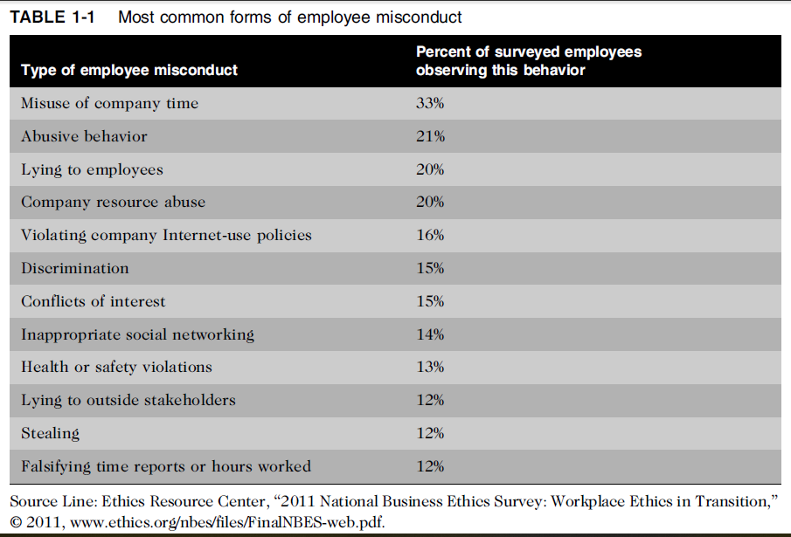
Low-level Employee misconduct:

Slide 18
Why Fostering Good Business
Ethics Is Important?
To gain the good will of the community
To create an organization that operates consistently
To foster good business practices
To protect organization/employees from legal action
To avoid unfavorable publicity

Slide 19
1. Gaining the Good Will of the Community
Organizations have fundamental responsibilities to
society
Declared in formal statement of company’s principles or beliefs
That’s include:
Making contributions to charitable organizations and nonprofit institutions
Providing benefits for employees in excess of legal requirements
Choosing economic opportunities that might be more socially desirable than profitable

Slide 20
1. Gaining the Good Will of the Community (Cont.)
Socially responsible activities create good will
Good will makes it easier for corporations to conduct business
The companies viewed as harmful may suffer a disadvantage.
For example, a corporation that pollutes the environment may find that opposing publicity, reduces sales, blocks relationships with some business partners, and attracts unwanted government attention.

Slide 21
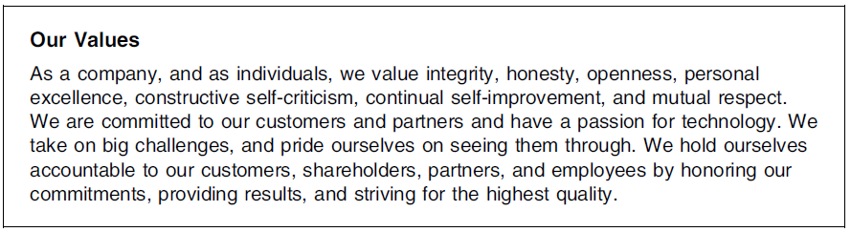
Microsoft’s statement of value

Slide 22
2. Creating an Organization That Operates Consistently
Why Consistency?
It is required for development of organizational culture
It also helps to expect what can be done in future from past
Consistency ensures that employees:
Know what is expected of them
Can employ the organization’s values to help them in decision making
Consistency also means that shareholders, customers, suppliers, and community know what they can expect of the organization
Notes:
Stakeholder: someone who stands to gain/loss depending on how a situation is resolved

Slide 23
2. Creating an Organization That Operates Consistently (Cont.)
Many companies share the following values:
Operate with honesty and integrity, staying true to organizational principles
Operate according to standards of ethical conduct, in words and action
Treat colleagues, customers, and consumers with respect
Strive to be the best at what matters to the company
Value diversity (variety)
Make decisions based on facts and principles

Slide 24
3.Fostering Good Business Practices
Good ethics means good business/improved profits
Retain customers even in competition with competitors
Companies that Produce safe and effective products
Avoid costly recalls and lawsuits(claims)
Provide excellent service that retains customers
Develop and maintain strong employee relations
Suffer lower turnover(income) rates
Enjoy better employee morale
Suppliers/business partners place priority on working with companies that operate in a fair and ethical manner

Slide 25
3. Fostering Good Business Practices (cont’d.)
Bad ethics means bad business/waning profits
Bad ethics can lead to bad business results
Bad ethics can have a negative impact on employees
A discrepancy between employee and organization:
Destroys employee commitment to organizational goals and objectives,
Creates low morale leads to poor performance,
Reduce employee involvement in organizational improvement initiatives,
Builds indifference to the organization’s needs.

Slide 26
4. Protecting the Organization and Its Employees from Legal Actions
In 1909, U.S. Supreme Court established that an employer can be held responsible for the acts of its employees
This principle is called respondeat superior
Coalition of several legal organizations debates establishment for ethics and compliance programs to reduce criminal liability of organization
Others claim company officers should not be given light sentences if their ethics programs are ineffective
Notes:
Coalition : union, alliance, partnership (If detect misconduct in the workplace)
Paneities or sentence should not so easy or simple….

Slide 27
5. Avoiding Unfavorable Publicity
Public reputation of company strongly influences:
Value of its stock
How consumers honor products and services
Degree of misunderstanding received from government
Amount of support and cooperation received
Organizations are motivated to build strong ethics
programs to avoid negative publicity
In 1202, google agreed $22.5Million on allegation of cookies and bypass privacy settings to track the online habits using Apple’s Safari browser. Fine was too low as income of a day but the lose of loyalty and bad publicity.

Slide 28
How to Improving Corporate Ethics?
Characteristics of a successful ethics program
Employees willing to seek advice about ethical issues
Employees feel prepared to handle situations that could lead to misconduct
Employees are rewarded for ethical behavior
Employees are not rewarded for success obtained through questionable means
Employees feel positive about their company
Ethic Resource Center (ERC) 86% of employees in well implemented ethics organization observe strong ethical culture
25% employee with little or no ethical program, promote integrity in workplace
Notes:
Ethic Resource Center (ERC) 86% of employees in well implemented ethics organization perceive strong ethical culture
25% employee with little or no ethical program, promote integrity in workplace

Slide 29
1. Appointing Corporate Ethics Officer
Corporate ethics (compliance) officer
Provides vision and leadership in business conduct
Should be well-respected, senior-level manager who reports directly to the CEO
Responsibilities:
Ensures ethical procedures are put in place
Creates and maintains ethics culture
Is responsible for key knowledge/contact person for ethical issues
Notes:
Needs:
First case: late 1980s, firms bribe to get information to improve contract bids
Second: 1990, new federal guidelines for referential treatment in prosecution of white collar crimes.
Several accounting scandals, load scandals etc

Slide 30
2. Ethical Standards Set by Board of Directors
Board oversees the organization’s business
activities and management
Board members of company are expected to:
Conduct themselves according to the highest standards of personal and professional integrity
Set standard for company-wide ethical conduct
Ensure submission with laws and regulations
Create environment in which employees can seek advice about business conduct, raise issues, and report misconduct
Notes:
Management for the benefits of all stakeholders
Board not responsible for daily issues of management but help to set ethical culture
Duties are assigned and send a msg to employee to follow
Also advise to raise issue, improve business conduct through appropriate channels

Slide 31
3. Establishing a Corporate Code of Ethics
Code of ethics:
Highlights an organization’s key ethical issues
Identifies principal values and important principles
Focuses employees on areas of ethical risk
Offers guidance for employees to recognize and deal with ethical issues
Provides mechanisms to report unethical conduct
Help employees accept by the law, follow necessary regulations, and behave in an ethical manner

Slide 32
3. Establishing a Corporate Code of Ethics (cont’d.)
Example:
Sarbanes-Oxley Act of July 30, 2002
Enacted in response to public violence over several major accounting scandals
Section 404 requires that the CEO(Chief Executive Officer) and CFO(Chief Financial Officer) sign any
SEC(Security and Exchange Commission) filing to attest to its accuracy
Section 406 requires public companies to disclose whether or not they have a code of ethics, and if any waivers to that code have been granted
Notes:
Chief Executive Officer (CEO)
Chief Financial Officer (CFO)
Security and Exchange Commission (SEC)
The Sarbanes-Oxley Act (become law from July 30, 2002) cracks down on corporate fraud. It created the Public Company Accounting Oversight Board to oversee the accounting industry. It banned company loans to executives and gave job protection to whistleblowers. The Act strengthens the independence and financial literacy of corporate boards. It holds CEOs personally responsible for errors in accounting audits.

Slide 33
3. Establishing a Corporate Code of Ethics (cont’d.)
Example continued..
Sarbanes-Oxley Act of July 30, 2002
Cannot gain company-wide acceptance unless it is:
Developed with employee participation
Fully endorsed by organization’s leadership
Must continually be applied to company’s decision
making and emphasized as part of its culture
Breaches in the code of ethics must be identified and dealt with appropriately

Slide 34
The Software Engineering Code of Ethics by IEEE
EIGHT principles that express responsibilities:
The public
The client and employer
The product
Professional judgment
Management
The profession
Colleagues
Self

Slide 35
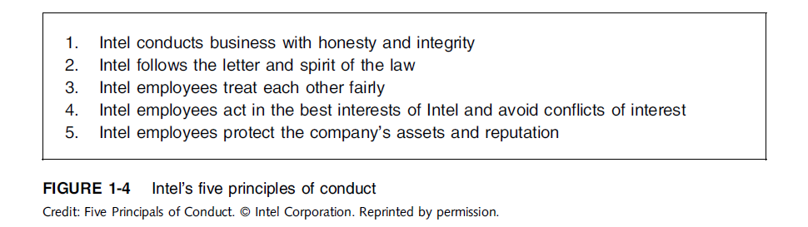
Establishing a Corporate Code of Ethics (cont’d.)

Slide 36
4. Conducting Social Audits
Social audit
Reviews how well organization is meeting ethical and social responsibility goals
Communicates new goals for upcoming year
Shared broadly with employees, shareholders, investors, market analysts, customers, suppliers, government agencies, and local communities

Slide 37
5. Requiring Employees to Take Ethics Training
Personal beliefs improved through education
Comprehensive ethics education program encourages employees to act responsibly and ethically
Often presented in small workshop formats
Employees apply code of ethics to hypothetical (supposed) but realistic case studies
Demonstration of recent company decisions based on principles from the code of ethics
Notes:
Convictions: views, beliefs

Slide 38
5. Requiring Employees to Take Ethics Training ….(cont’d.)
Critical issue is that training increase the percentage of employees who report incidents of misconduct
Employees must:
Learn effective ways of reporting incidents
Be reassured their feedback will be acted on without retaliation

Slide 39
6. Including Ethical Criteria in Employee Appraisals
Only 43% of companies include ethical conduct in
employee’s performance appraisal
Reported by 2012 surveyed in 2014: www.ehow.com/about_6574961_ethicsawareness-training.html
Ethical criteria include:
Treating others fairly and with respect
Operating effectively in a multicultural environment
Accepting personal accountability
Continually developing themselves and others
Operating openly and honestly with all

Slide 40
7. Creating an Ethical Work Environment
Organizational culture must maintain ethical culture consistently.
Good employees may make bad ethical choices
May be encouraged to do “whatever it takes” to get the job done
Employees need a knowledgeable resource to
discuss perceived unethical practices
A manager
Legal or Internal Audit Department
Business Unit’s legal counsel
Anonymously through internal Web site
Notes:
To achieve a target

Slide 41
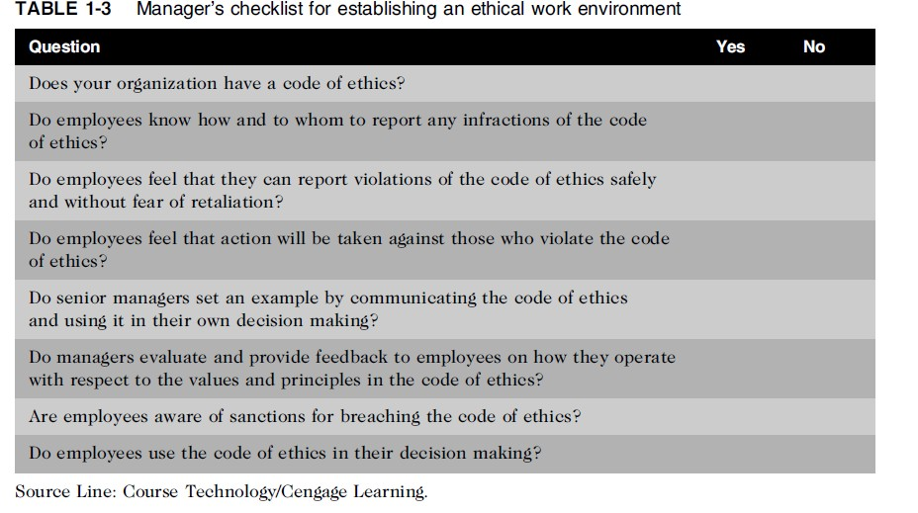
7. Creating an Ethical Work Environment
(cont’d.)

Slide 42
Including Ethical Considerations in Decision Making
Steps in a decision-making process
Develop problem statement
Identify alternatives
Evaluate and choose alternative
Implement decision
Evaluate results
Success

Slide 43
1. Develop a Problem Statement
Clear, concise description of the issue
Answers these questions:
What causes people to think there is a problem?
Who is directly affected by the problem?
Is there anyone else affected?
How often does it occur?
What is the impact of the problem?
How serious is the problem?
Most critical step in decision-making process

Slide 44
2. Develop a Problem Statement .(cont’d.)
Example of a good problem statement:
“Our product supply organization is continually running out of stock of finished products, creating an out-of-stock situation on over 15 percent of our customer orders, resulting in over $300,000 in lost sales per month.”
Examples of poor problem statements:
“We need to implement a new inventory control
system.” (possible solution, not a problem statement)
“We have a problem with finished product inventory.”
(not specific enough)

Slide 45
2. Identify Alternates:
Enlist help to brainstorm alternative solutions
3. Evaluate and choose alternative
Evaluate by weighing laws, guidelines, and principles
Consider likely consequences of each alternative
Alternative selected must:
Be ethically and legally defensible
Be consistent with policies and code of ethics
Take into account impact on others
Provide a good solution to problem

Slide 46
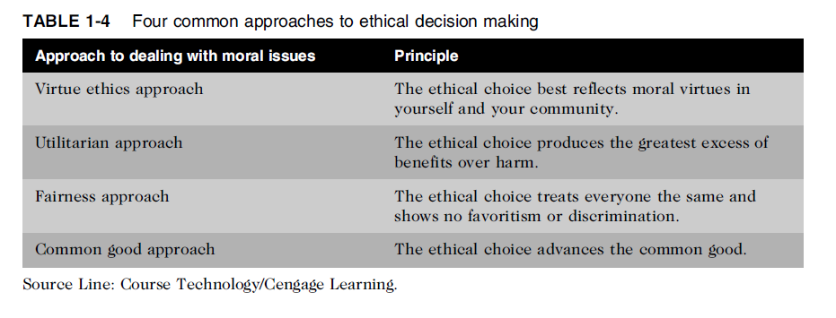
Common Approaches to Ethical
Decision Making
Table 1-5 Four common approaches to ethical decision making

Slide 47
4. Implement the decision
Efficient, effective, timely implementation
Communication is key for people to accept change
Transition plan made easy and pain-free
5. Evaluate the results
Monitor results for desired effect
Observe impact on organization and stakeholders
Return to “Develop problem statement” step if further refinements may be needed

Slide 48
Virtue Ethics Approach
Virtue ethics approach
Focuses on concern with daily life in a community
People guided by virtues to reach “right” decision
More effective than following set of principles/rules
Problems
Does not provide guide for action
Virtue cannot be worked out objectively; depends on
circumstances

Slide 49
Utilitarian Approach
Utilitarian approach
Chooses action that has best overall consequences
Finds the greatest good by balancing all interests
Fits concept of value in economics and the use of cost-benefit analysis
Problems
Measuring and comparing values is often difficult
Predicting resulting benefits and harm is difficult

Slide 50
Fairness Approach
Fairness approach
Focuses on fair distribution of benefits/burdens
Guiding principle is to treat all people the same
Problems
Decisions can be influenced by personal bias
Others may consider the decision unfair

Slide 51
Common Good Approach
Common good approach
Work together for common set of values and goals
Implement systems that benefit all people
Problems
Consensus is difficult
Some required to bear greater costs than others

Slide 52
Ethics in Information Technology
Public concern about the ethical use of information technology includes:
E-mail and Internet access monitoring
Downloading in violation of copyright laws
Unwanted e-mail (spam)
Hackers and identify theft
Students and plagiarism
Cookies and spyware
Notes:
Unsolicited: Unwanted, Uninvited

Slide 53
Ethics in Information Technology (cont’d.)
The general public does not understand the critical
importance of ethics as applied to IT
Important decisions are often left to technical experts
General business managers must assume greater responsibility for these decisions by:
Making decisions based on technical understanding, business know-how, and a sense of ethics
Creating an environment where ethical problems can be discussed openly, objectively, and constructively

